Slide 1
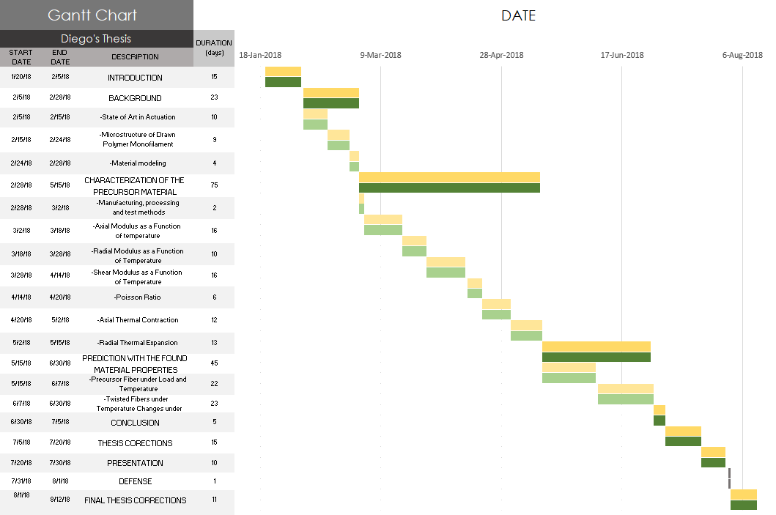
Collecting Data
Writing
Completed Work

